Slide 1


DESIGN 1
Lesson 3: Build and Connect the F1 Website
Ms. Abboud • Grade 9 - Design 1 • Term 1, Week 5

Slide 2
Learning Objectives
WALT - We Are Learning To
WILF - What I'm Looking For
Build a four-page website from scratch.
Connect the pages with a navigation menu of hyperlinks.
All 4 files are created with the correct names.
The navigation menu is at the top of every page.
Every link works when I click it.

Slide 3
Frayer Model: Relative Link (Review)
DEFINITION
CHARACTERISTICS
A link using just a filename or short path (e.g. about.html) to point to another page within the same project.
Just a filename/path; no https://; points within the same project.
RELATIVE LINK
EXAMPLES
NON-EXAMPLES
href="about.html"
href="https://www.wikipedia.org" (an absolute link)

Slide 4
National Identity Integration
UAE Government Digital Services: UAE government and company websites share the same core pages, like About Us, Vision and Mission, and Contact Us, connected by one clear menu. Today you build that same structure for an F1 website, the sport of the Abu Dhabi Grand Prix.

Slide 5
STARTER
Which Pages Does Every Website Have?
Think of a website you use often.
Which pages does it almost always have? Name 3.
Hook • Engage & Ask
5 - 10 minutes

Slide 6
LESSON CORE
I Do: One Folder, Four Files
Every page is its own .html file, saved in the same folder.
Every page starts with the same skeleton. Only the title and the text change.
Gradual Release of Responsibility
30 - 40 minutes
Example: the Home page skeleton (index.html)
<!DOCTYPE html>
<html>
<head>
<title>F1 World - Home</title>
</head>
<body>
<h1>Welcome to F1 World</h1>
</body>
</html>
1 / 3

Slide 7
LESSON CORE
We Do: Home Page and Menu Together
Create index.html and add the Home page text from the Page Content sheet.
Add the navigation menu at the top: Home, About Us, Contact Us, Vision and Mission.
Save and open it in the browser.
Gradual Release of Responsibility
30 - 40 minutes
2 / 3

Slide 8
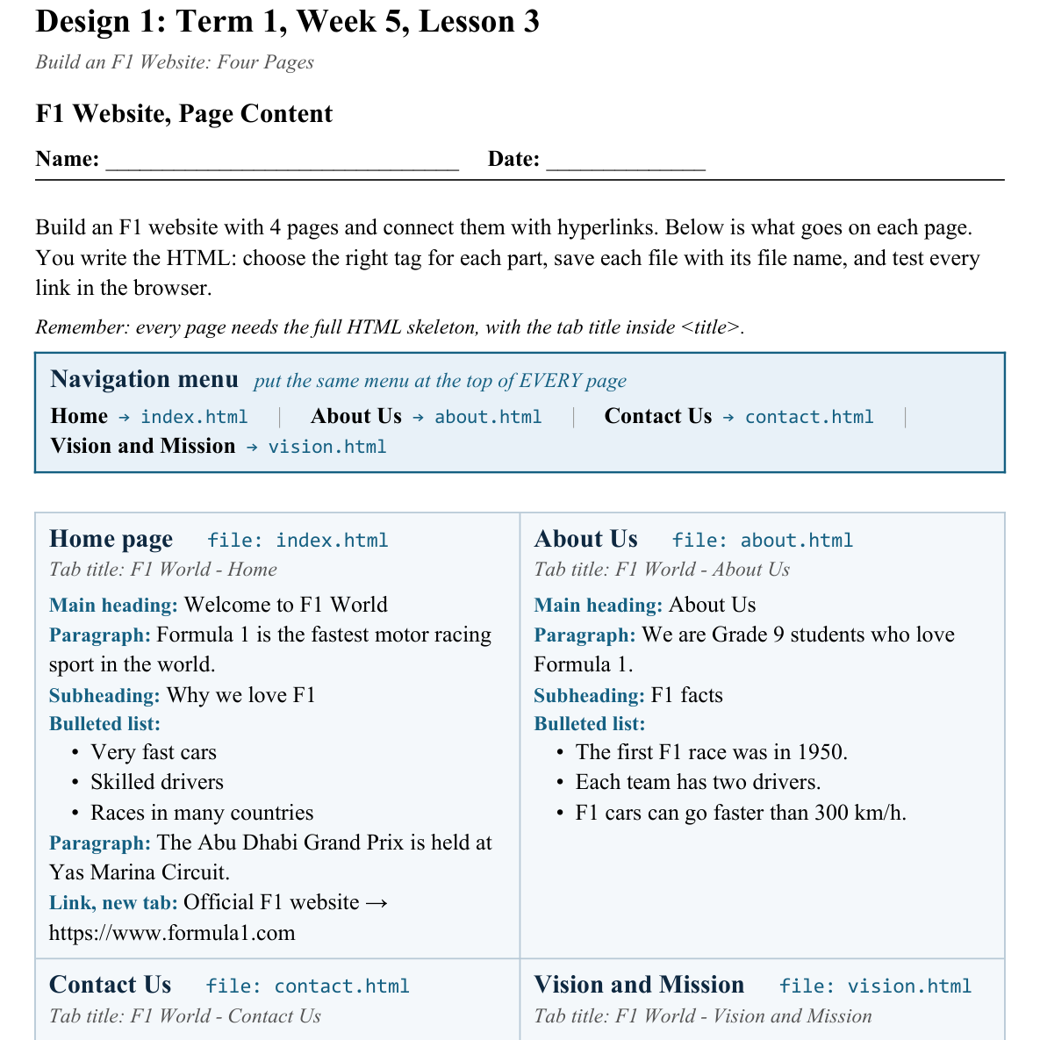
LESSON CORE
You Do: Build and Connect
Build the other 3 pages from your Page Content sheet.
Put the same menu at the top of every page, then test every link.
Activity: F1 Website, Page Content
Gradual Release of Responsibility
30 - 40 minutes
3 / 3

Slide 9
CLOSURE
Click Through
Show a partner you can reach every page from every other page using your menu.
Next lesson: finish and check your site for the formative.
Transition & Extend
5 - 10 minutes

